Slide 1
Drupal - Create a Multi-lingual Site
By
Vimalnath Ravichandran (51324815)

Slide 2
Overview
A website becomes multilingual when it has the ability to use several languages.
A multilingual website is any website that offers content in more than one language. Usually, it makes sense to have a multilingual website when your target audience consists speakers of different languages.
Drupal has got some in-built modules which helps in language translation, however not everything. To felicitate the same, we have some contributed modules.
There are many different possible configurations depending on your website needs, domain names and content.
There are different modules to choose from both Core and Contributed in order to display the content in the desired language.

Slide 3
Overview – Drupal an ideal way
Drupal would be the ideal platform for creating multilingual websites with ease.
The fundamentals are provided by Drupal core, while extended functionality is added via contributed/custom modules.
As of Drupal 6, multilingual support is (partially) included in Drupal core. However, this support does not allow building complete multilingual sites and you will need to install additional contributed modules.
The Translation Management module makes it easy to run multilingual Drupal sites. It helps management, content admins, translators and web developers by creating a systematic translation process.

Slide 4
Overview – URL Structure
There's no need to create separate URLs when developing a multilingual website. Moreover users could identify the language of a page just by glancing at the URL.
For example, the following URLs allows users know that they’re on the English section of this site: http://test.ca/en/index.html http://en.test.ca/index.html Now a page in Russian would be: http://test.ca/rus/index.html http://rus.test.ca/index.html Also, URL structure will make it easier for you to analyze the indexing of your multilingual content.

Slide 5
Modules Required
Let us quickly go through the modules that are available in Drupal for achieving a multi-lingual site.
Core-optional Modules Required:
Locale
Content translation
Locale – This module enables the translation of the user interface to languages other than English. Make sure that this module is enabled from admin/build/modules.
Localizer allows translation of the following system objects: * Blocks * Menus * Nodes * Taxonomy * System settings (variables)
Content translation - This module works with the Translation module in Drupal core. This core-optional module needs to be enabled as well.

Slide 6
Modules Required
Contributed Modules Required:
Internationalization – In layman's terms, Internationalization is the process of designing a software application so that it can be adapted to various languages and regions without engineering changes. The terms are frequently abbreviated to the numeronym i18n (where 18 stands for the number of letters between the first i and last n in internationalization and of course this module is a collection of modules to extend Drupal core multilingual capabilities and be able to build multilingual sites. This can be downloaded from http://drupal.org/project/i18n.

Slide 7
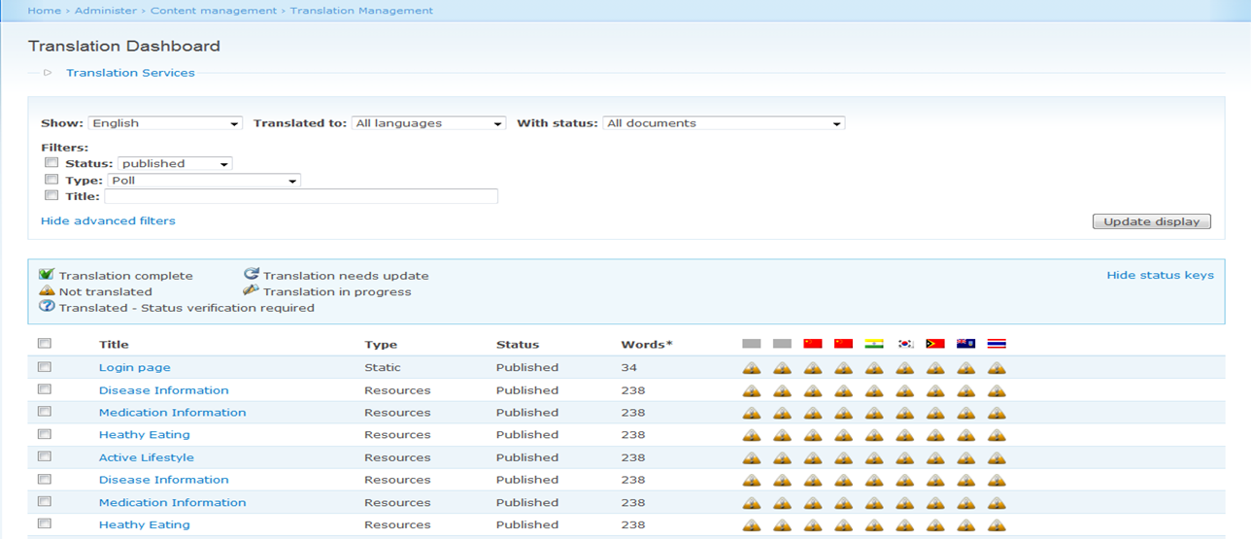
Modules Required
Contributed Modules Required:
Translation Management – This module adds a layer of management for multilingual contents. The Translation Management module makes it easy to run multilingual Drupal sites. It provides complete workflow management for multilingual Drupal sites. It provides with a translational dashboard that helps us to see what contents are translated and contents that needs translation.

Slide 8
Install i18n Module
Download the i18n module from http://drupal.org/project/i18n
and extract the contents to /sites/all/modules (this is the path where all the contributed/custom modules would go).
Download the Translation Management module from http://drupal.org/project/translation_management
Now, we need a translational file (portable object)so that the content already present in English could be translated to the preferred language.
The portable object(po) file can be downloaded from this link http://localize.drupal.org/translate/languages
For explanation, we would try to translate the content from English to Chinese.
So, download the Chinese po file from this link http://localize.drupal.org/translate/languages/zh-hant

Slide 9
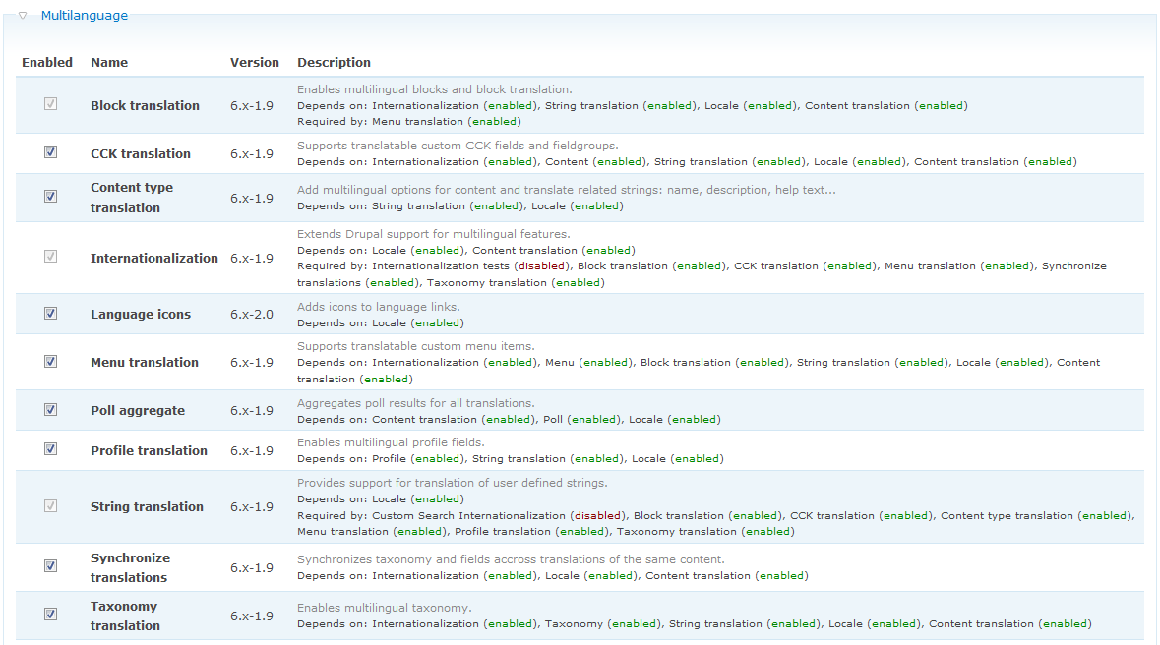
Enabling i18n and Translation Management
Enable all available under Multilanguage section in /admin/build/modules.
If you haven't enabled Poll and Profile modules, Drupal asks you if you want them enabled. If you don't want them, in the Multilanguage - i18n don't enable Multilanguage Poll and Multilanguage Profile.

Slide 10
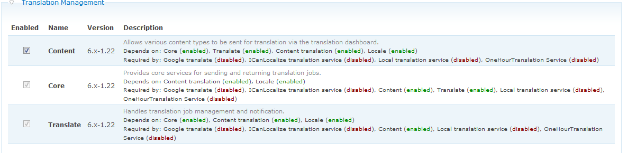
Enabling i18n and Translation Management
Enable all available under Translation Management section in /admin/build/modules.

Slide 11
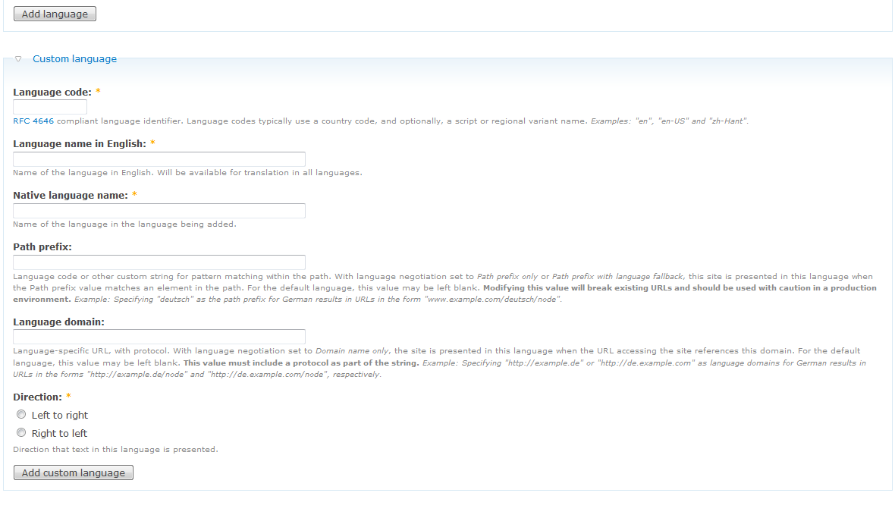
Setting up the language
Navigate to /admin/settings/language and select "Add language". Add all the desired languages.
Choose language code as appropriate(zh-hant), in our case its Chinese, Traditional.
Enter Language name as "Chinese, Traditional”.
Choose the direction to be “Left to right”.
Save the configuration.

Slide 12
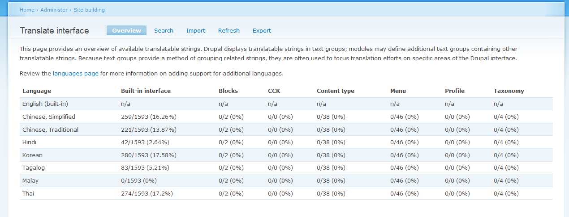
Import po file
Once i18n module is enabled, go to admin->Site Building->Translate interface.
This page provides an overview of available translatable strings.
We can now import the Chinese po file which we have downloaded already.

Slide 13
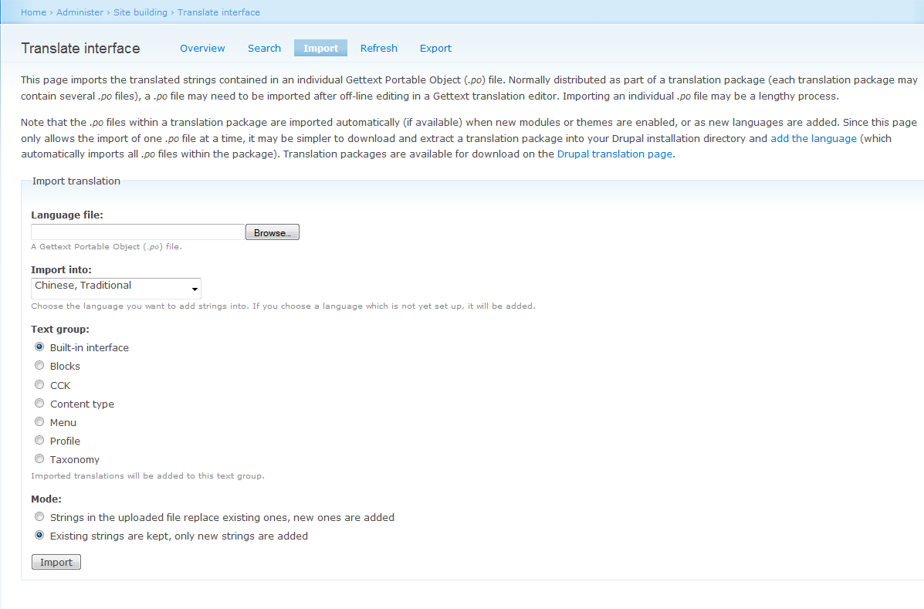
Import po file
Click “browse” to upload the po file.
Choose the Import Into Option(in our case it is “Chinese, Traditional”)
Click import button at the bottom to finish the setup.

Slide 14
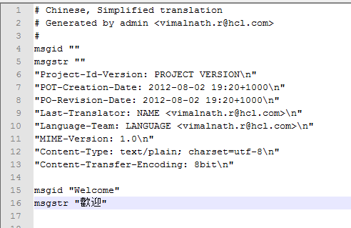
Update the po File
Now that we have uploaded the po file , we could just make few changes to that po file and test if the content is rendered in Chinese.
After making changes a typical po file would resemble this way:
Here, “msgid” is the word which needs to be translated and ”msgstr” is the equivalent string in Chinese.
Again, import the updated po file.

Slide 15

For testing, we are going to translate “Welcome” to Chinese, Traditional.
The code should be formatted in such a way that the string is enclosed inside a t function.
E.g.: <?php print t("Welcome");?>
After making the changes, refresh the page.
The highlighted string you see in the here is the translated string(Welcome) in Chinese, Traditional.

Slide 16
References
Drupal i18nDocumentation http://drupal.org/project/i18n
Drupal’s locale module :http://api.drupal.org/api/drupal/modules!locale!locale.module/6
Tutorial Examples: http://drupal.org/node/275705

Slide 17
Thank you!
Please feel free to communicate/report your opinions/feedbacks/comments/errata to
vimalnath.r@hcl.com and provide your valuable suggestions.

